Slide 1


High School Endorsements &
4 Year Plans
Parent Chat

Slide 2
Objective:
We will explore how to prepare for the high school classes your child will need to take.
We will explore the 5 possible endorsements to choose from in high school.

Slide 3

Planning your future - What are your options?
2-Year College
Certification Program
4-Year College
Technical or Trade School
Military
Career
Notes:
You’ll have many options after high school. Each option requires a level of preparation, so the choices you make and the courses you take are important. Your graduation plan is the Foundation High School Program, or FHSP + Endorsements. The plan requires a total of 26 credits.
While there are some required courses, there is a lot of flexibility in choosing your course of study. You will want to plan carefully to be sure you’re prepared for your goals after high school.
In this unit, we will look at your options and you will have the chance to create a Personal Graduation Plan, or PGP, that will help guide you through to graduation!

Slide 4

High School Foundation (basic 22 classes everyone needs)
“The Plain Cupcake”
English – 4 credits/classes
•English I, II, III, and English IV*
Math – 3 credits/classes
•Algebra I, Geometry, and Algebra II*
Science – 3 credits/classes
•Biology, Integrated Physics and Chemistry (IPC), or Chemistry, or Physics, and one additional science
Social Studies – 3 credits/classes
•US History, government (.5 credit), economics (.5 credit), and either World History or World Geography
Language Other than English (LOTE) – 2 credits/classes
•Credits must be in the same language
Fine Arts – 1 credit/class
Physical Education – 1 credit/class
Health – .5 credit (one semester)
Communication Skills - .5 credit (one semester)
Electives – 4 credits
*not a “required” course, but HIGHLY recommended
Notes:
The foundation requires 22 credits from the areas of English, Math, Science, Social Studies, Languages Other Than English, Fine Arts, PE and Electives.
Think of the foundation as a cupcake with no icing!

Slide 5
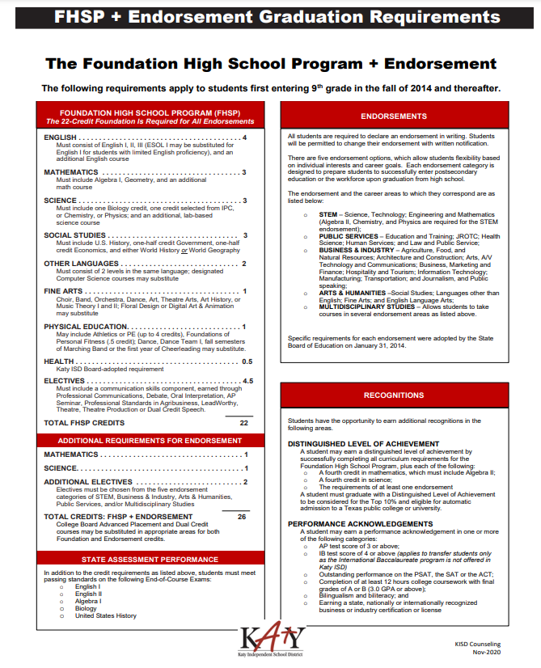

Slide 6

The Endorsement / 4X4
The Icing on top of the Cupcake
In addition to those required for the 22-credit Foundation High School Program:
The Endorsement—4 Credits
  1 additional math credit
  1 additional science credit
  2 additional elective credits
The 4X4—Colleges prefer
  4 years of Math, English, Science, and Social Studies
In addition to those required for the 22-credit Foundation High School Program
Notes:
So what is an endorsement? The endorsement is built on top of the 22-credit foundation. An endorsement is a course of study related to your individual interests and goals. This allows you to choose specialized classes that will prepare you for reaching your goals after high school. When choosing your endorsement, you should consider your interests and strengths. An Endorsement requires four additional credits. These must include one additional math credit, one additional science credit and two additional elective credits.
Think of the fourth math and science credits as the icing on the cupcake.
.

Slide 7
The Endorsement
The Icing on top of the Cupcake
The endorsement is a course study related to your individual interests and goals. There are 5 endorsement pathways:
STEM (science, technology, engineering, and math)
Business and Industry
Public Service
Arts and Humanities
Multidisciplinary Studies
Whichever endorsement you select dictates which courses you will take in addition to your foundation courses. Each endorsement requires 4 additional courses, so you will graduate with 26 credits.

Slide 8


STEM- Science ● Technology ● Engineering ● Math
The following job clusters fall under the STEM endorsement pathways:
Mathematics
Science
Computer Science
Career and Technical Education (CTE) related courses - Engineering
*(Algebra II, Chemistry and Physics are required for the STEM endorsement)

Slide 9

Business & Industry
The following job clusters fall under the Business & Industry endorsement pathways:
Agriculture, Food & Natural Resources
Architecture & Construction
Arts, A/V Technology & Communications
Business Management & Administration
Finance
Hospitality & Tourism
Information Technology
Manufacturing
Marketing
Transportation, Distribution & Logistics

Slide 10

Public Service
The following job clusters fall under the Public Service endorsement pathways:
Health Science: EMT, Pharmacy Tech, Nurse, Pharmacist, Doctor
Education & Training
Government & Public Administration
Human Services: Cosmetology
Law, Public Safety, Corrections & Security
NJROTC (National Junior Reserve Officer Training Corps)

Slide 11




Arts and Humanities
The following job clusters fall under the Arts and Humanities endorsement pathways:
Social Studies
Languages Other Than English
Fine Arts
English Language Arts

Slide 12

Multidisciplinary Studies
This endorsement allows students to take a course of study selected from several endorsement areas as listed below:
4 Advanced courses from other endorsement areas
4 credits in each core subject area including English IV and Chemistry and/or Physics
4 credits in Advanced Placement or dual credit selected from English, Math, Science, Social Studies, other language (LOTE), or fine arts

Slide 13
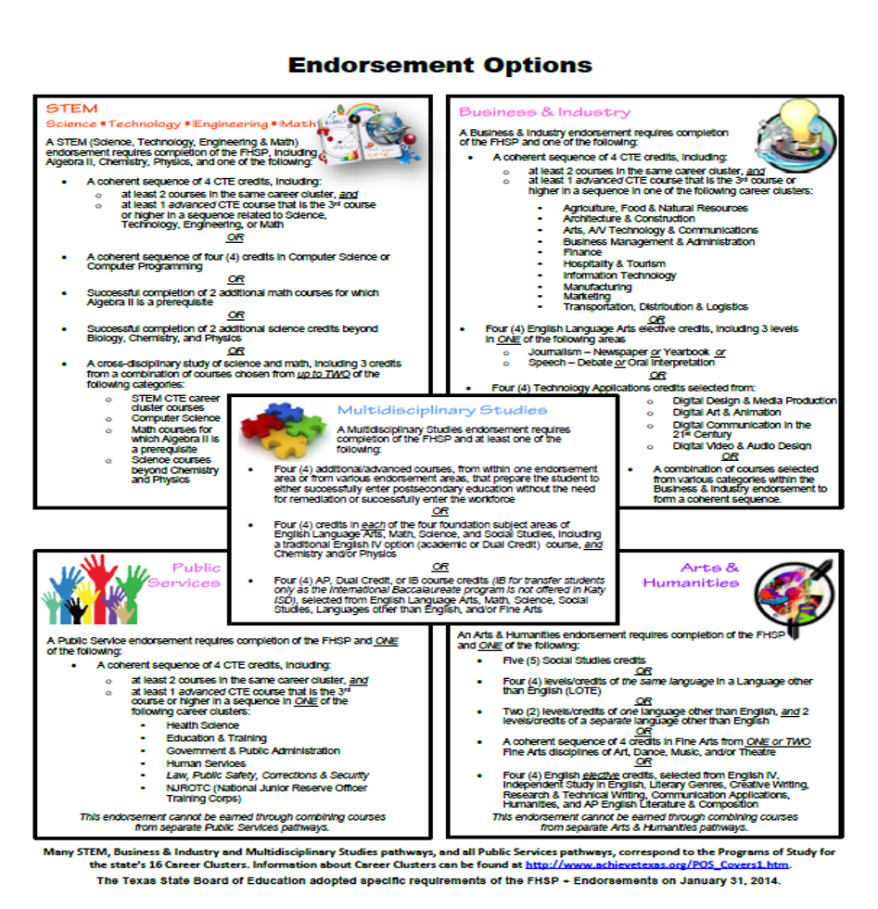
Endorsements
The endorsement is a course of study related to your individual interests and goals. There are 5 endorsement pathways.
    STEM (science, technology, engineering, and math)
    Business and Industry
    Public Service
    Arts and Humanities
    Multidisciplinary Studies
Whichever endorsement you select dictates which courses you will take in addition to your foundation courses. Each endorsement requires 4 additional courses, so you will graduate with 26 credits.
Notes:
Now we will look at each of the five endorsement categories so you can choose courses that support the endorsement you want to pursue. When you are choosing your endorsement, think about the areas that you are truly interested in studying. Signing up for an endorsement requires you to commit to that program of study, so it is important that you make a decision that is a good fit for you. You are able to change your mind if you decide on another career path.

Slide 14
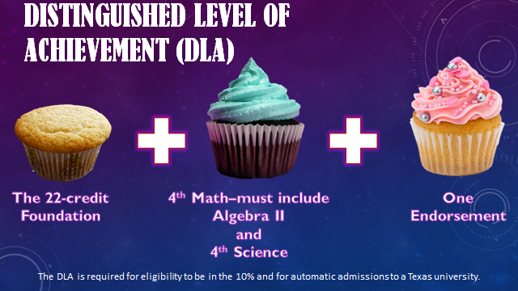
Distinguished Level of Achievement (DLA)=Sprinkles
4 Math Credits and 4 Science credits are required for all endorsements.
Algebra II is required for the DLA
The 4X4—Colleges prefer
  4 years of Math, English, Science, and Social Studies
Notes:
The Distinguished Level of Achievement, or DLA is important because it is REQUIRED for a student to be considered for the Top 10% and therefore be eligible for automatic admission to a Texas public college or university.
The requirements for a DLA are pretty much the same as those for any endorsement; but, Algebra II is specified as a requirement for earning the DLA, regardless of which endorsement you choose to pursue.
The Distinguished Level of Achievement will be noted on the transcript and diploma.

Slide 15



INFORMATION FOR STUDENTS TAKING
High school credit courses
Requirements to qualify for automatic admission consideration:
Complete the FHSP + Endorsement, including the Distinguished Level of Achievement,
Earn a satisfactory ACT or SAT score,
Submit the application before the college or university’s deadline, and
Provide a final high school transcript verifying completion of the FHSP + Endorsement, including the Distinguished Level of Achievement.
TOP
10%
All semester grades and grade points earned in high school credit courses become a permanent part of the student’s high school transcript and are factored into the student’s grade point average and class rank.

Slide 16
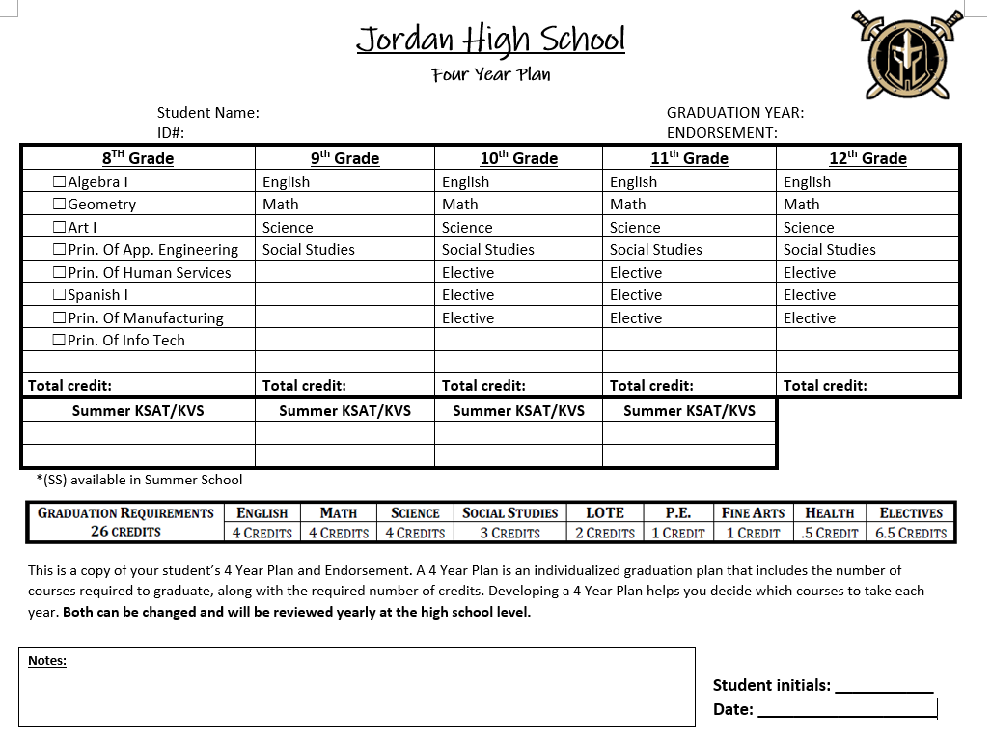
The 4 Year Plan
The 4 Year Plan is a personal graduation plan that is just that...it’s personalized!
What are your interests?
What are your goals?
The Foundation Plan allows flexibility and choices, so you are able to choose the course of study that best fits YOU!
We will develop this plan this year in SchooLinks. It is a fluid document. It can, and most likely, will change throughout high school.
Notes:
Now we will focus on your Personal Graduation Plan, or PGP. The PGP should be tailored to YOUR interests and goals. Consider things you are good at and things that you like. You will use the PGP to map out which courses you plan to take throughout high school. Don’t worry, if you change your mind along the way, you can make changes.

Slide 17
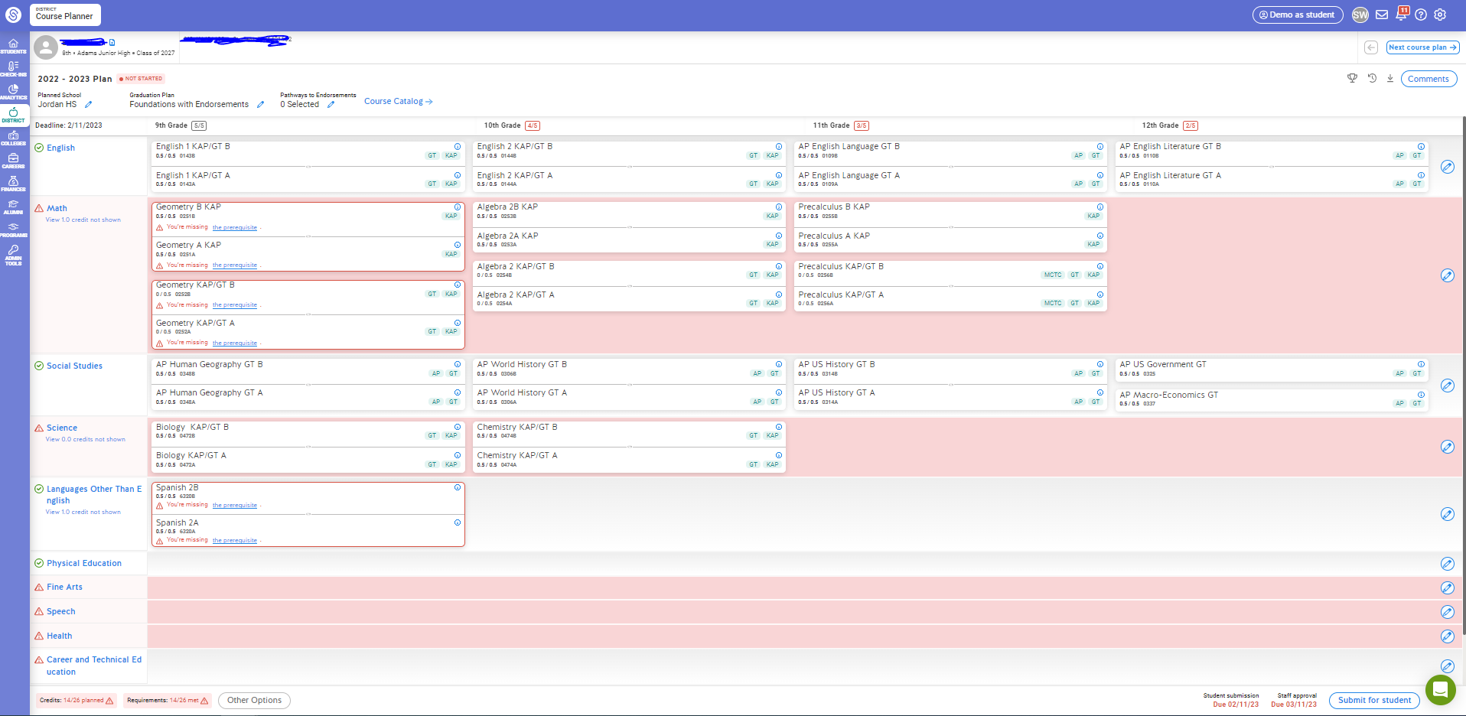

Tools for Planning
ONLINE ONLY THIS YEAR
AJH Counseling Website under the Course Selection Tab

Slide 19
How it looks in SchooLinks

Slide 20
High School Credit Courses in JH
Some high school credit courses are available to junior high students. High school credit courses available to be taken in 8th grade include:
*Algebra I
*Art I for High School Credit (one year of junior high art required)
*Spanish 1
*Spanish for Spanish Speakers (by approval only)
*Business Information Management (BIM)
*Principles of Applied Engineering (recommended corequisite Algebra I)
*Principles of Information Technology
*Principles of Arts, A/V, Technology, and Communications
*Principles of Human Services
*Career Launchpad

Slide 21
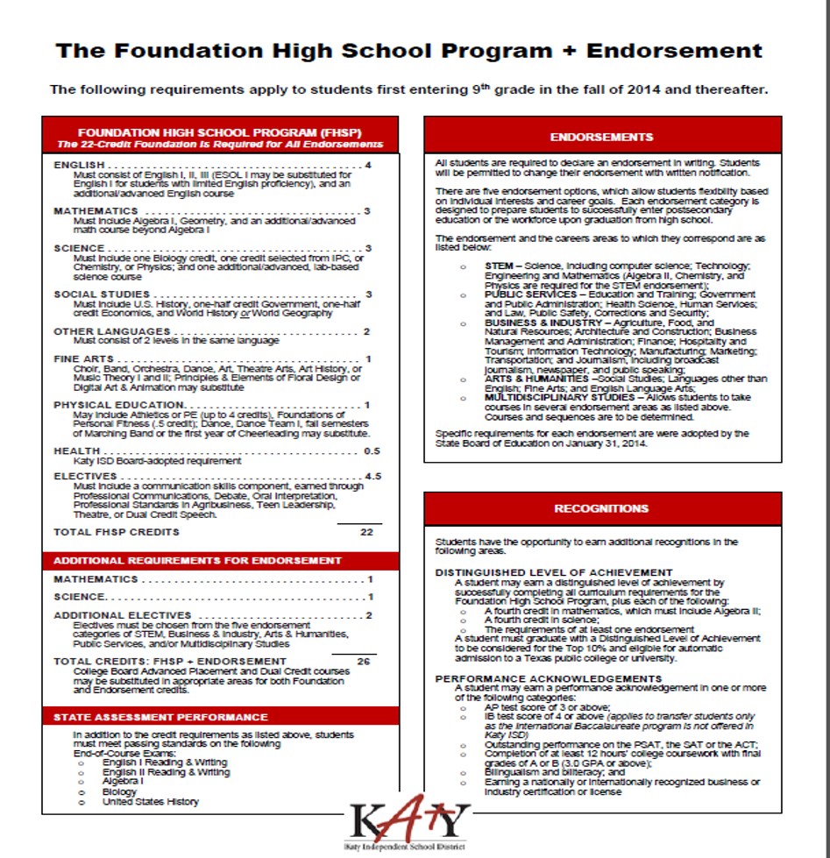
PLANNING YOUR FOUNDATION:
ENGLISH LANGUAGE ARTS
Four credits of English are required, including
    English I
    English II
    English III
    A fourth English credit
Courses that satisfy the additional English credit are listed at the top of the Personal Graduation Plan
Notes:
Your course selections must include English I, English II and English III.
“Traditional” English IV credits include academic English IV, AP English Literature, and dual credit English, but there are several other courses that can satisfy the fourth English credit. These courses are listed at the top of the PGP.
Beginning with 9th grade, write your English course selections on the top line of the PGP.

Slide 22
PLANNING YOUR FOUNDATION:
MATH
The Foundation requires three Math credits, and a fourth Math credit is required for the FHSP + Endorsement. The credits must include
    Algebra I
    Geometry
    A third Math credit
    A fourth Math credit
Courses that satisfy the additional Math credits are listed at the top of the Personal Graduation Plan
Notes:
Your course selections must include Algebra I and Geometry, plus two additional math credits. The Distinguished Level of Achievement also requires Algebra II among the four math credits.
If you’re taking high school credit math in JH, begin in the Junior High column.
Additional math courses are listed at the top of the PGP.

Slide 23
PLANNING YOUR FOUNDATION:
SCIENCE
The Foundation requires three Science credits, and a fourth Science credit is required for the FHSP + Endorsement. The credits must include
    Biology
    IPC, or Chemistry, or Physics
    A third Science credit
    A fourth Science credit
Courses that satisfy the additional Science credits are listed at the top of the Personal Graduation Plan
Notes:
Your science credits must include Biology—taken in 9th grade—and IPC or Chemistry or Physics, plus two additional science credits. As mentioned earlier, major Texas colleges prefer for students to have both Chemistry and Physics. Additional science courses are listed at the top of the PGP.

Slide 24
PLANNING YOUR FOUNDATION:
SOCIAL STUDIES
Three Social Studies credits are required, including
    World Geography or World History or AP Human Geography
    US History
    Government (.5 credit)
    Economics (.5 credit)
Courses that satisfy the additional Social Studies credits are listed at the top of the Personal Graduation Plan
Notes:
Your three social studies credits must include US History, which is taken in 11th grade, and Government and Economics, taken in 12th grade.
You must also take either World Geography (a 9th grade option) or World History (in 10th grade). Again, major Texas colleges prefer students to have both World Geography and World History.

Slide 25
PLANNING YOUR FOUNDATION:
LOTE ∙ PHYSICAL EDUCATION ∙ FINE ARTS
Additional required credits include
    Two LOTE credits
      Must include Level 1 and Level 2 of the same Language Other Than English
    One PE credit
    One Fine Art credit
Courses that satisfy LOTE, PE and Fine Art credits are listed at the top of the Personal Graduation Plan
Notes:
There is a lot of flexibility in choosing courses to meet the requirements for PE, Fine Arts, and LOTE, which means Languages Other Than English, like foreign languages. If you’re taking Spanish I and or Art I for high school credit, place them in the Junior High column.

Slide 26
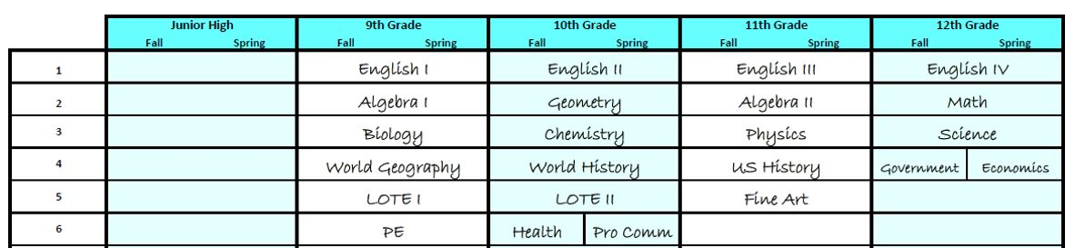
Example of Completed 4 Year Plan with the Foundational 22 Credits

Slide 27

Miller Career & Technology Center (MCTC)
MCTC Website
Junior High Preview Night will be on January 24th at 6:00pm
MCTC Course Information

Slide 28

MCTC Recruitment Video

Slide 29

Tools for Planning
Start with your child’s interests and aptitudes.
Helps your child pick classes that are of interest.
When building the 4 year plan, start with the Foundation (22 Credits)
Then choose the other electives.
Remember, this is a fluid document.

Slide 30


Slide 31

AJH Counseling Website
Please visit our counseling website as it contains lots of great information for all things Adams Junior High!

